Slide 1
Machine Learning For Startup Success Prediction

Slide 2
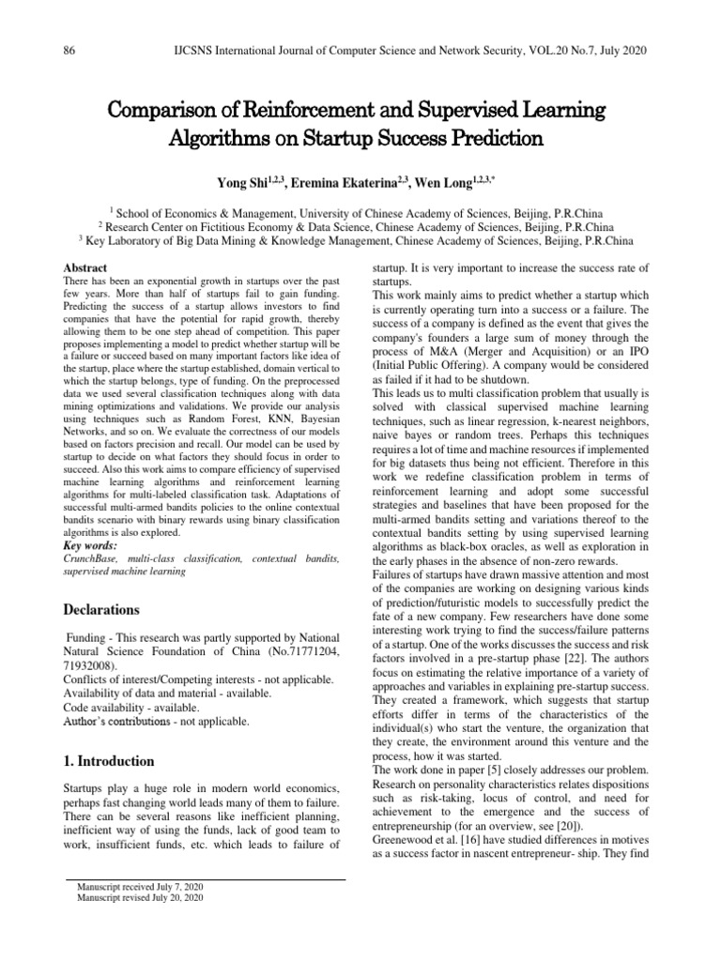
Introduction to Startup Success Prediction
Machine Learning (ML) techniques can analyze complex datasets to forecast startup outcomes.
Accurate prediction models help investors and entrepreneurs make informed decisions.
This presentation explores how ML can be leveraged to predict startup success effectively.
Notes:
Image source: https://imgv2-1-f.scribdassets.com

Slide 3
Importance of Predicting Startup Success
Early prediction can reduce investment risks and optimize resource allocation.
Successful forecasts enable startups to identify growth opportunities and potential pitfalls.
Understanding success predictors fosters better strategic planning for entrepreneurs and investors.
Notes:
Image source: https://imgv2-1-f.scribdassets.com

Slide 4

Key Factors Influencing Startup Success
Founding team experience, skills, and network connections significantly impact outcomes.
Market size, competition level, and product-market fit are critical external factors.
Business model scalability and financial health also play essential roles in success prediction.
Notes:
Image source: https://imgv2-2-f.scribdassets.com

Slide 5
Data Collection for ML Models
Relevant data includes financial metrics, team backgrounds, and market data.
Data sources encompass public records, social media, surveys, and industry reports.
Quality and completeness of data are crucial for building reliable and accurate models.
Notes:
Image source: https://imgv2-1-f.scribdassets.com

Slide 6
Feature Engineering and Selection
Transform raw data into meaningful features that capture underlying patterns.
Techniques like normalization, encoding, and dimensionality reduction improve model performance.
Selecting the most predictive features enhances model interpretability and accuracy.
Notes:
Image source: https://imgv2-1-f.scribdassets.com

Slide 7
Machine Learning Algorithms Used
Common algorithms include Logistic Regression, Random Forests, and Gradient Boosting Machines.
Deep learning models can capture complex, non-linear relationships in data.
Ensemble methods combine multiple models to improve overall prediction accuracy.
Notes:
Image source: https://imgv2-1-f.scribdassets.com

Slide 8
Model Training and Validation
Models are trained on historical startup data to learn success patterns.
Cross-validation techniques help assess model robustness and prevent overfitting.
Performance metrics like accuracy, precision, recall, and AUC are used to evaluate models.
Notes:
Image source: https://imgv2-1-f.scribdassets.com

Slide 9
Challenges in Startup Success Prediction
Data scarcity and quality issues can hinder model development.
The highly dynamic nature of markets and startups introduces unpredictability.
Ethical considerations include data privacy and avoiding biases in predictions.
Notes:
Image source: https://imgv2-1-f.scribdassets.com

Slide 10
Practical Applications and Case Studies
Investment firms use ML models to screen potential startup investments efficiently.
Accelerators leverage predictive analytics to select high-potential startups.
Case studies demonstrate improved success rates and resource allocation through ML insights.
Notes:
Image source: https://imgv2-1-f.scribdassets.com

Slide 11
Future Directions and Conclusion
Integration of real-time data streams will enhance prediction accuracy.
Combining ML with human expertise creates more comprehensive assessment frameworks.
Machine Learning holds significant promise for reducing uncertainty and fostering startup success.
Notes:
Image source: https://imgv2-1-f.scribdassets.com

